Slide 1
Introduction to image processing and analysis with ImageJ / Fiji. Part 3 Digital image processing
Dale Moulding
UCL Institute of Child Health Imaging Facility

Slide 2
Image processing rules: Dos and Don’ts
Manipulation should be done on a copy not the original data
Simple adjustments to the entire image are usually acceptable
Check journal’s guidances
Ethical guidelines: http://www.ncbi.nlm.nih.gov/pubmed/20567932
Be honest, always describe the adjustments made
Do not hide information (brightness, contrast, level)
Do not create/destroy information (interpolation, bit-depth conversion)
http://jcb.rupress.org/cgi/content/full/166/1/11 JCB article about image manipulation.
http://swehsc.pharmacy.arizona.edu/micro/digital-image-ethics Nice article, picking the best image is not the same as picking the image that fits your hypothesis!

Slide 3
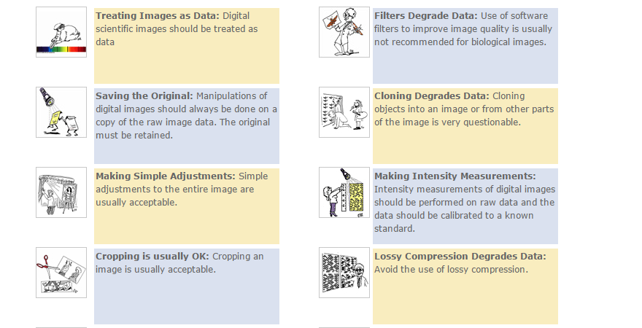
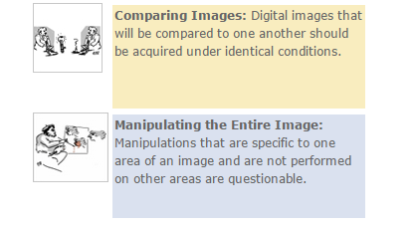
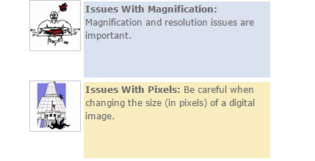
Image processing rules: An online guide.
http://ori.dhhs.gov/education/products/RIandImages/guidelines/list.html
Journals will check your images – they look for noise in the background, smoothing artefacts, replicated images, etc…

Slide 4
Background correction
Even background across the image
Image>adjust>Brightness-Contrast
Uneven background
Process>Substract Background (rolling ball algorithm)
Flat field correction (brightfield)
Image Calculator Plus Plugin
Many other ways …
http://imagejdocu.tudor.lu/doku.php?id=howto:working:how_to_correct_background_illumination_in_brightfield_microscopy

Slide 5
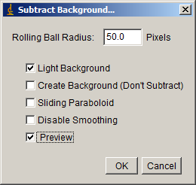
Rolling Ball http://rsbweb.nih.gov/ij/docs/guide/146-29.html#toc-Subsection-29.14
Radius should be set to at least the size of the largest object that is not part of the background
Several iterations may improve the results
Useful to remove white background on gel
Good for Colocalisation
Exercise 1) Rolling ball background correction

Slide 6
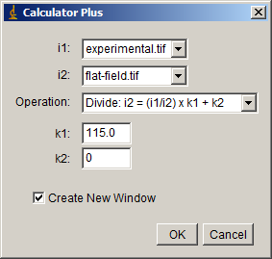
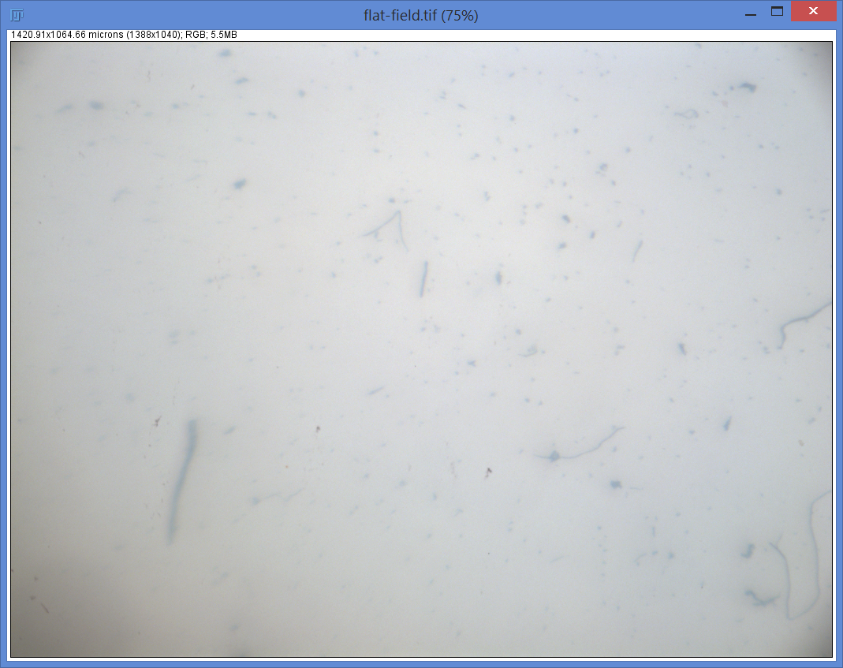
Flat-field correction (Image Calculator Plus Plugin)
http://rsbweb.nih.gov/ij/plugins/calculator-plus.html (Process / Calculator plus)
Exercise 2) Image Calculator Plus
i1 : experimental image
i2 : background image
Average intensity of the flat field image
(this number is wrong, the correct value is found by ‘Analyze / Set Measurements / mean grey value.
Select all (Crtl + A), Measure (M)
i1 : can be a stack, then the background is removed from every image!

Slide 7
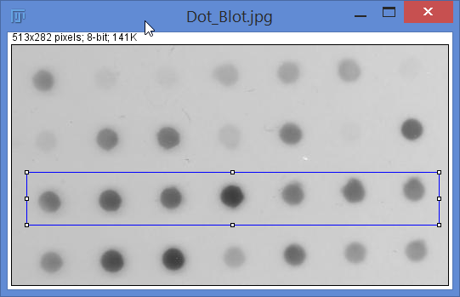
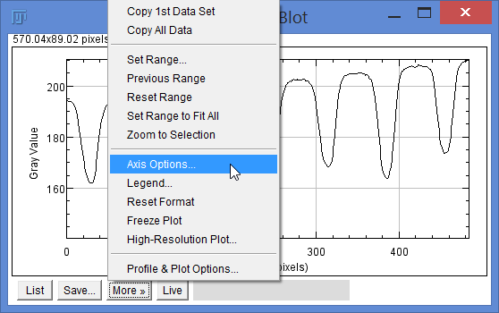
Profile plot (shortcut = K)
http://rsbweb.nih.gov/ij/docs/guide/146-30.html#sub:Plot-Profile-[k]
Displays a two-dimensional graph of the intensities of pixels along a line or rectangular selection.
How to measure dot blots and Westerns…
Method 1: draw a rectangle on first dot press CTRL 1, move to second lane CTRL2, all lanes, CTRL2, last lane CTRL3.
Method 2:
Remove X and Y gridlines

Slide 8
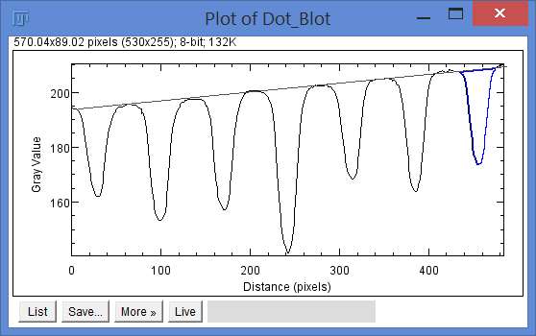
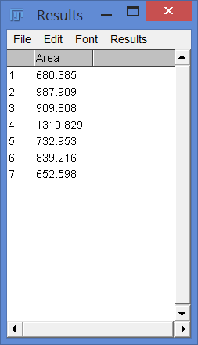
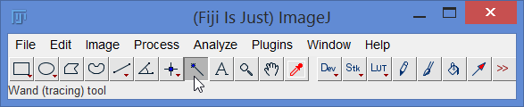
Measure (shortcut = M)
Saves measurements to Results table
Draw line to define background. (shortcut = D)
Use magic wand to highlight each peak
Measure
Results can be Saved as (File / Save as) and excel file

Slide 9
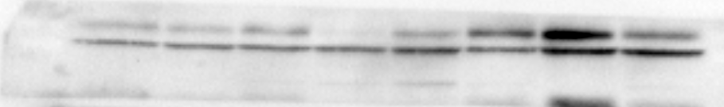
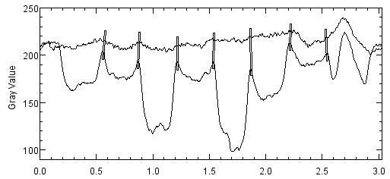
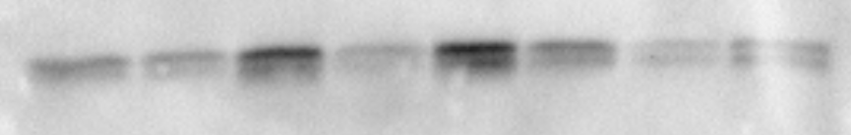
How to measure Westerns
Exercise 3) Measure western blot
Uneven background, lanes very close together, different widths, other bands close by.
Use segmented line tool.
Set the line width to cover the bands.
Plot profile.
Move the line up or down and plot profile of background.
Remove gridlines.
Adjust range.
Use Process / Image Calculator and combine the 2 graphs with ‘min’

Slide 10
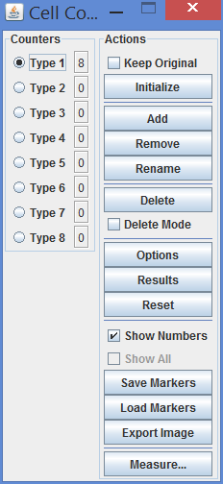
Manual Particle counting
ImageJ can facilitate manual counting
“Cell counter” plugin (Plugins / Analyze / Cell counter)
You click each cell and it gets marked and counted.
Exceedingly dull, slow, but if done carefully very accurate.
Exercise 4) Manual Cell Counter

Slide 11
Image Segmentation & automatic counting
Automatic image analysis has benefits and pitfalls.
Pros:
Quick
Unbiased
n = lots!
Cons:
Never 100% accurate (but n = lots!)
Time consuming to set up.

Slide 12
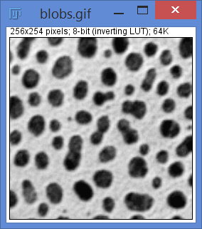
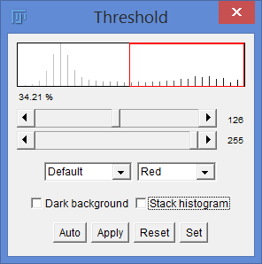
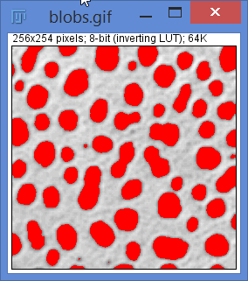
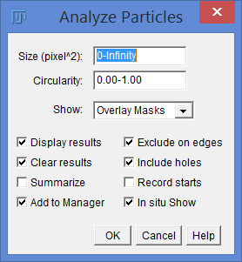
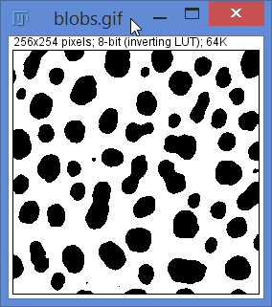
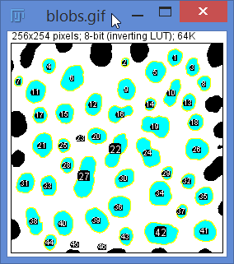
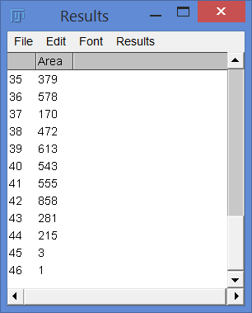
Threshold (shift+T)
Exercise 5) Automatic counting - Threshold
46 blobs (excluding edges)
But, are some overlapped?
Are some too small?

Slide 13
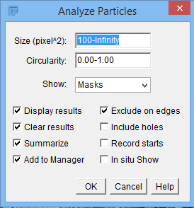

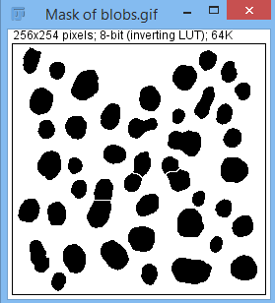
Threshold (shift+T)
Process /
Binary /
Watershed
(splits over-
lapping blobs)
45 blobs (excluding edges)
Split the overlapped ones
Excluded little ones.

Slide 14
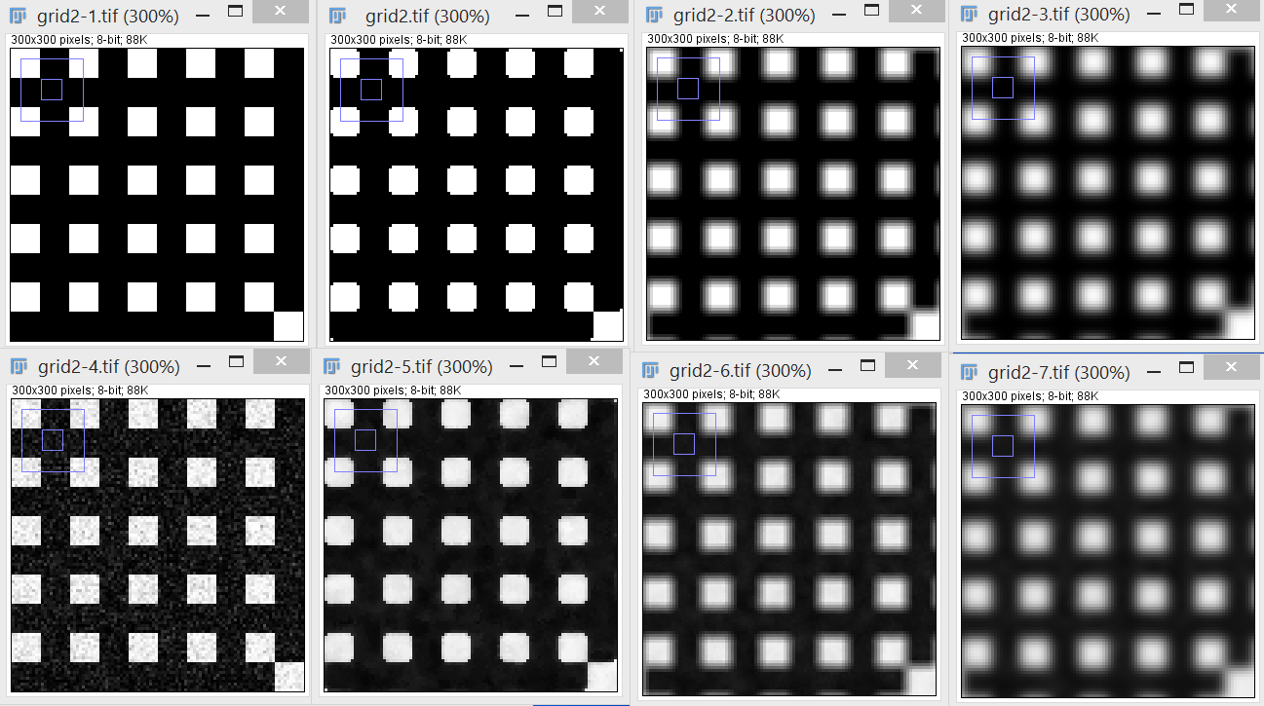
Spatial filters
http://rsbweb.nih.gov/ij/docs/guide/146-29.html#toc-Subsection-29.11
Smooth
Sharpen
Detect edges
Noise
Filters
Median
Mean
Gaussian
Example:
EM filtering, try a few… Median filter keeps edges. Gaussian and Mean smooth edges.

Slide 15
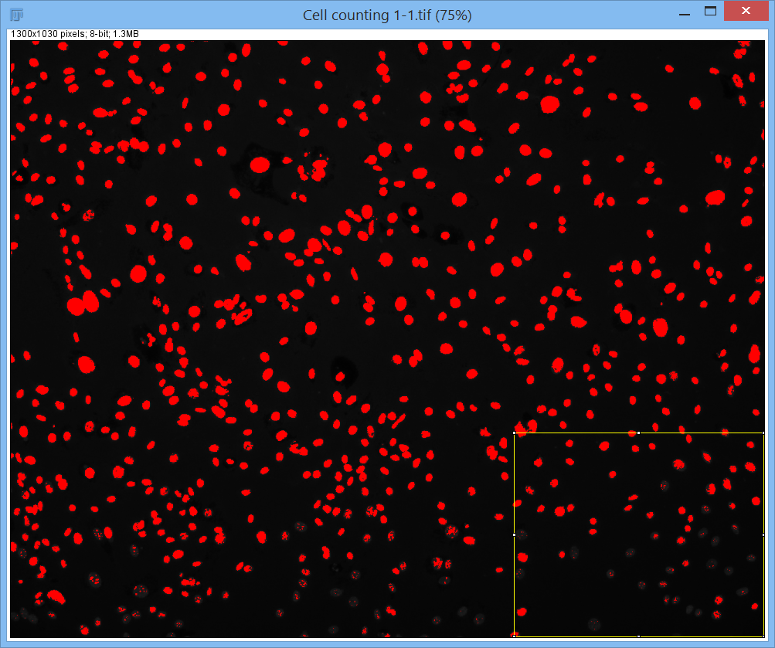
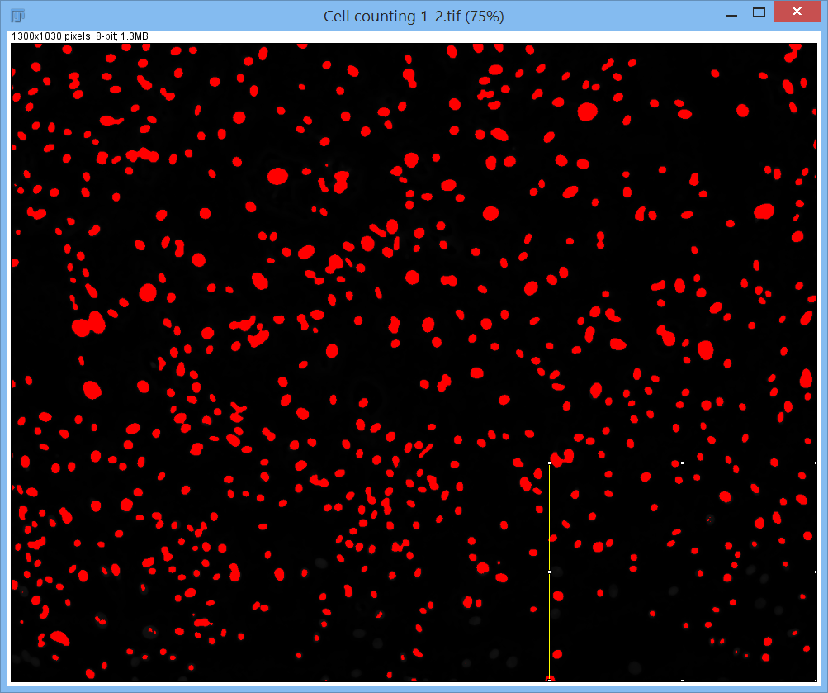
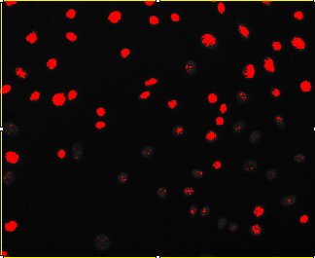
What about real samples?
Exercise 6) Automatic counting – Real images
Open file:
Cell counting 1.

Slide 16
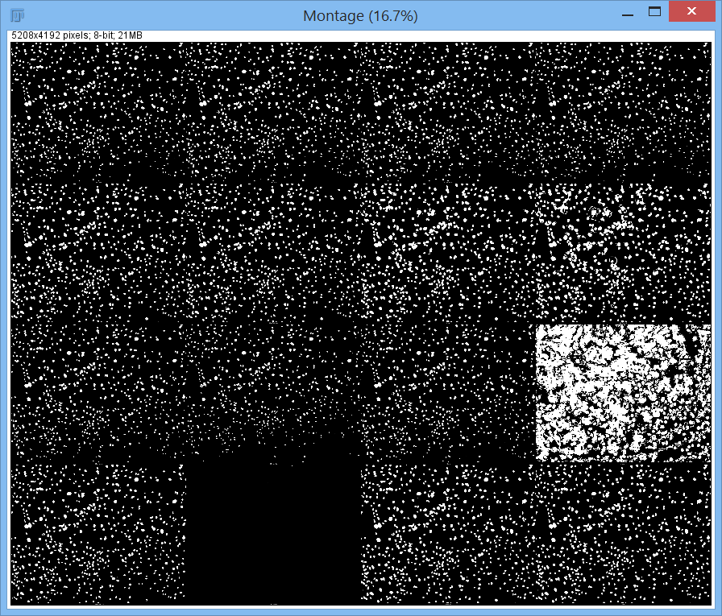
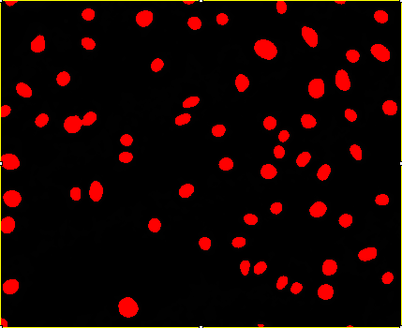
What about real samples?
Try different segmentation algorithms
Image / Adjust / Autothreshold… try all
(or auto local threshold, set it to 20…)
Background correction & median filter then Threshold by Triangle (method 15)

Slide 17
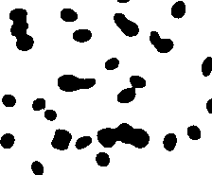
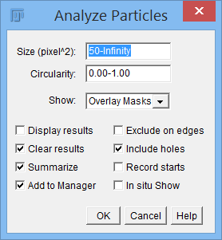
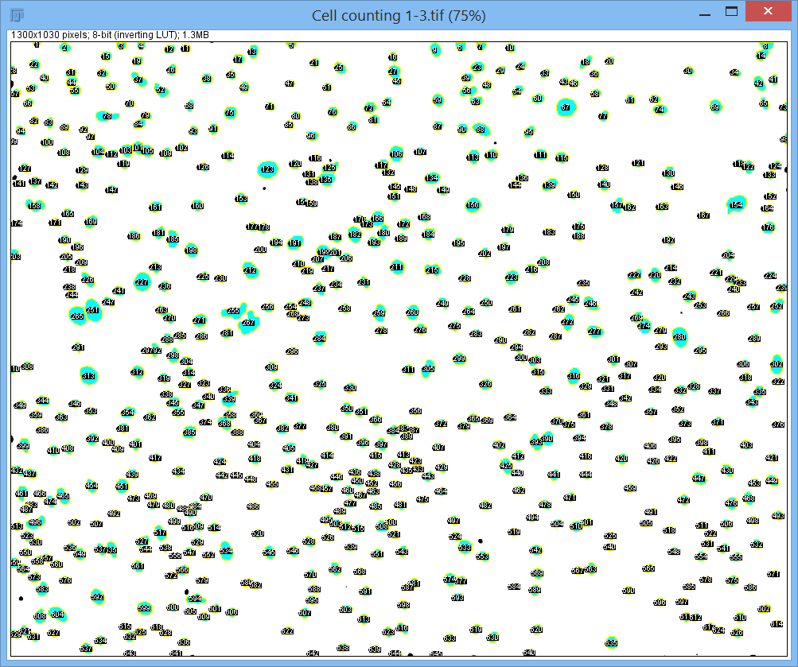

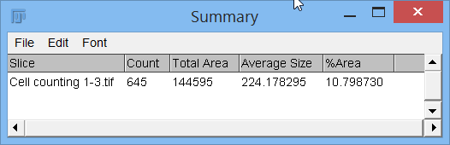
What about real samples?
Process / Binary / Watershed

Slide 18
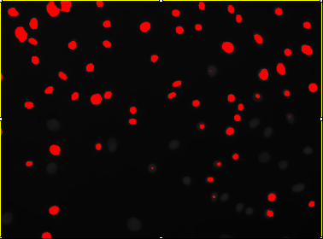
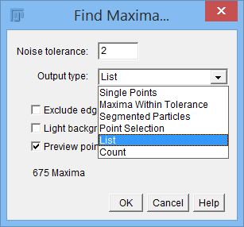
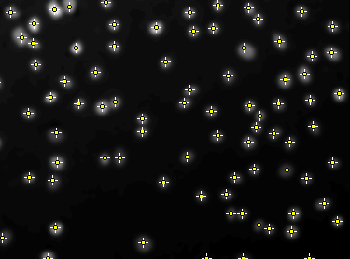
What about real samples?
Alternatively, use Process /Find Maxima
Subtract background (20). Filter / Gaussian (3),
Then find maxima (2, preview, adjust tolerance)
Bingo!

Slide 19
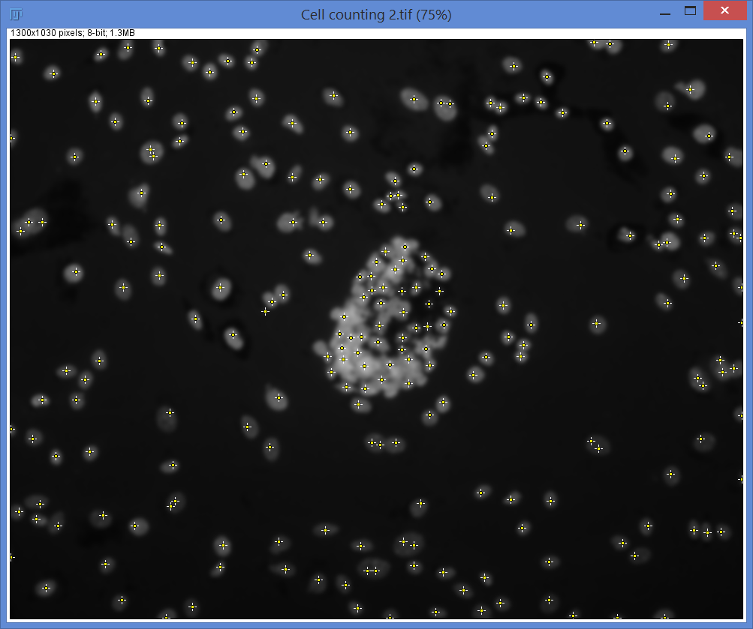
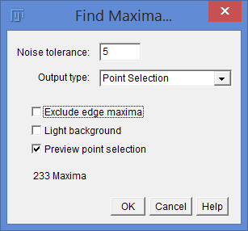
What about real samples – 2!
Open file:
Cell counting 2
Image / Type 8 bit
Gaussian (3) Filter
then Find Maxima
Try: Maxima Within Tolerance

Slide 20
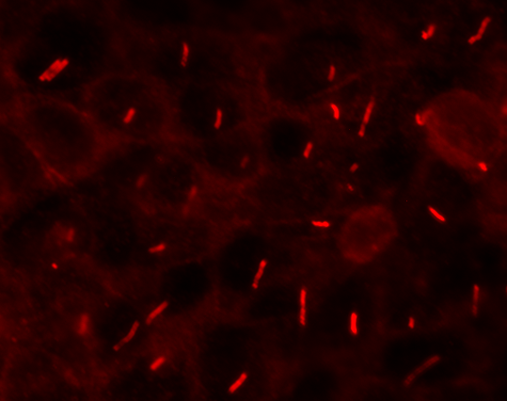
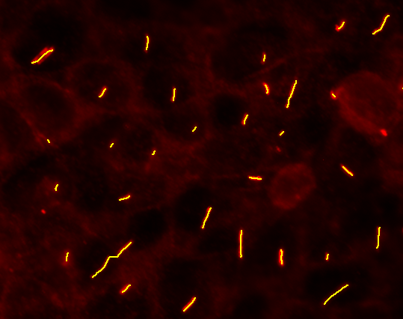
What about real samples – 3!
Exercise 7)
Cilia. Need to know how many and how long they are.
Find maxima no good (only counts them).
Therefore, segment to a binary image then measure the lengths.
How??
Image: Images for users/ Cilia lengths. Choose one image.
Hints:
Background correction. Filter (keeping edges).
Binary Dilate and skeletonize.
Macro: Images for users/ Macros/ Cilia2Dlengths.

Slide 21
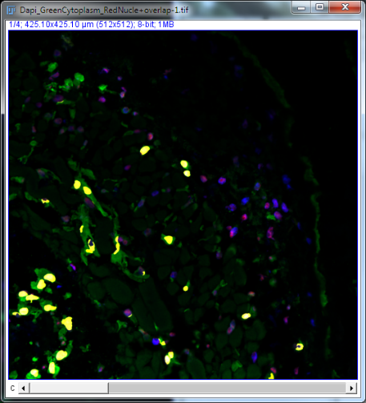
Identifying double stained cells
Exercise 8)
Often you need to measure cells that are positive for a particular stain.
A nuclear or cytoplasmic marker.
Use thresholding to make a binary image of each channel, then use ‘Image Calculator’ to add or subtract images from each other to identify overlaps.
File: Images for users/ Double Stained cells/ Dapi_GreenCytoplasm_RedNuclei.lsm
Procedure:
Dapi: Median(3). Threshold Triangle. Watershed. Analyze particles (20) Masks.
Green: Median(2). Threshold Default.
Analyze paricles (50) Masks.
Red: As for Dapi.
Image Calculator:
Mask C2 AND C3
Combine orig 3 colours + new binary image.

Slide 22
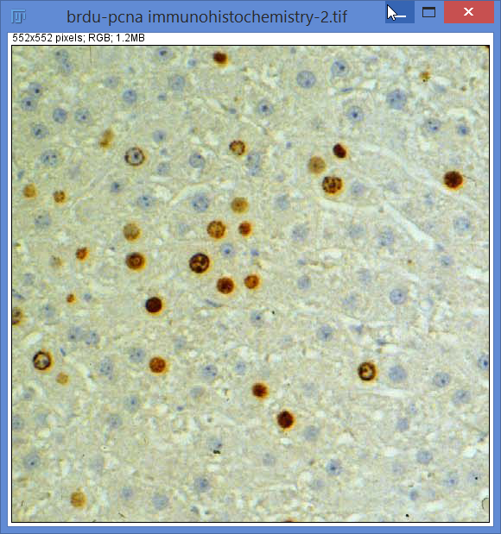
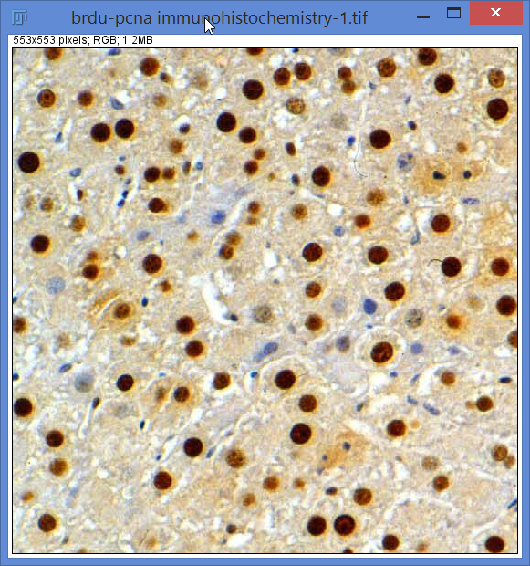
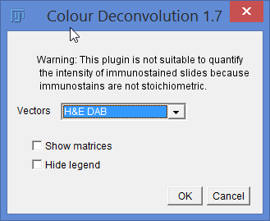
Histology staining analysis:
Colour deconvolution
Image / Color / Color Deconvolution

Slide 23
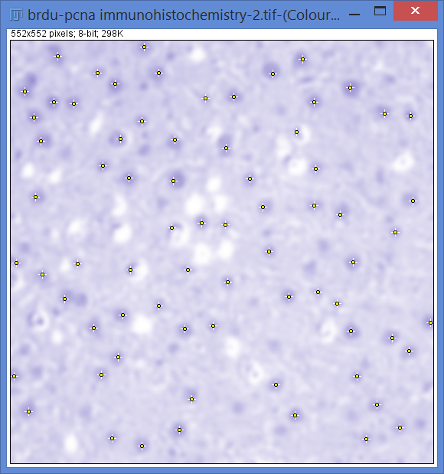
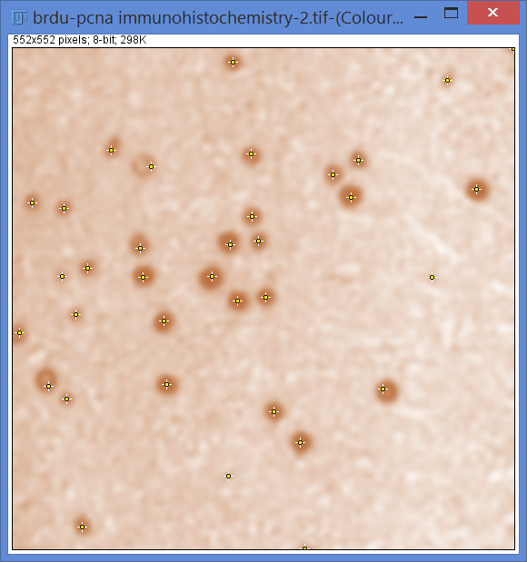


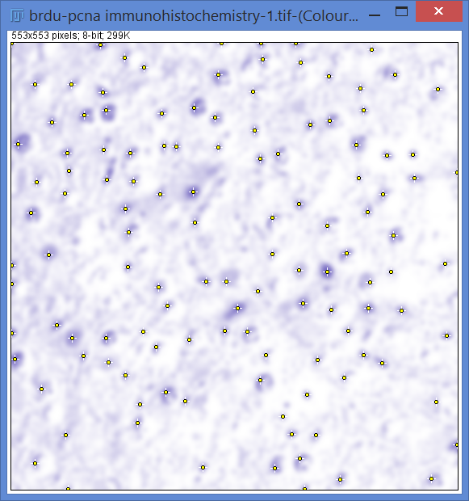
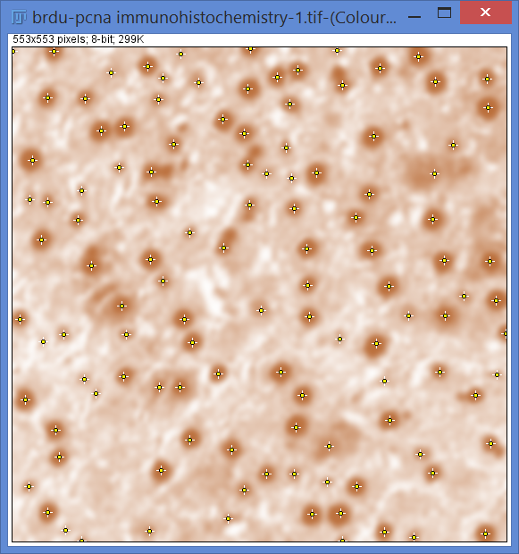
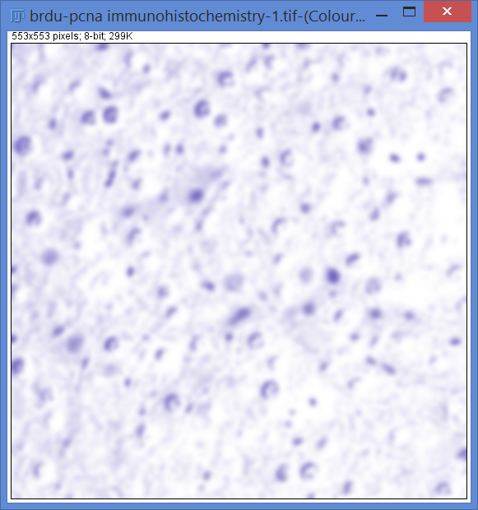


Slide 24

Macros http://rsb.info.nih.gov/ij/developer/macro/functions.html
Customisable automation
Written in Macro language
Macro can be recorded
Try it…
Files: Gut 7 ki67 circ
Macros: Ki67_find_maxima_noROI.ijm
Drag Ki67 maxima macro to imageJ, open first image. Run macro
Do it manually with Plugins / Macro / record … Create
Change ‘run’ to ‘doCommand’

Slide 25

Macros - 2
Can be used to process lots of files, and use any ImageJ function
This example is from ancient fossilized rice grains…
Files: Rice (folder)
Macro: RiceEllipses-CourseVersion.ijm (open the macro – drag to ImageJ)
Need to measure:
Length,
Width,
Area,
Shape descriptors.

Slide 26


Macros - 3
Or can analyse stacks, here is a scratch assay…
Files: Wound Healing (folder)
Macro: wound_healing.ijm (open the macro – drag to ImageJ)

Slide 27
Macros – 4: more examples
Other Examples :
Some imaging outputs your files into individual folders.
Macro: MoveFilesToSingleFolder.ijm
Files: try the ‘Images for Users’ folder
Takes all files from a folder and all subfolders, puts them into a single folder.
If you have a folder full of individual dapi, green, red immunofluorescence images.
Macro: Batch Create 3 colour stack & autocontrast.ijm
Files: Drosophila cells folder
Automate putting 3 colour fluorescent images together.
Sets auto-contrast to fill image histogram for each channel.

Slide 28
Macros – 5: Write a macro to count drosophila nuclei in a folder full of files.
Exercise 9 &10)
Adapt other macros rather than write from scratch.
Use Macro recorder to work out the counting procedure.
Try find maxima, or thresholding.
Try and save the results, perhaps save the summary window at the end.
Try and save an image for each file to see how accurate the counting was.

Slide 29


Tracking
In Fiji Plugins>Tracking …
Manual Tracking – Best is MTrackJ
http://www.imagescience.org/meijering/software/mtrackj/
http://www.imagescience.org/meijering/software/mtrackj/quickstart/
MTrack2 (automatic but glitchy)
TrackMate (can be very accurate – needs practice)
File: neutrophils.tif
Add (start a new track).
Clickety clickety…
Measure
Save.
ICY software, very powerful automatic tracking.

Slide 30
3D visualisation
Image>Stacks>3D project …
Volume viewer
http://rsbweb.nih.gov/ij/plugins/volume-viewer.html
ImageJ 3D viewer
Supports macros
5D dataset
http://rsbweb.nih.gov/ij/docs/guide/userguide-25.html#toc-Subsection-25.6
Open Samples>T1 Head
Open Samples>Fly Brain
Open Samples>Mitosis
Course Images>Zebrafish branchial arches.tif

Slide 31
Segmentation plugins
Statistical region merging
WEKA Trainable segmentation
Segmentation editor
Simple neurite tracer
SIOX: Simple Interactive object extraction
3D Objects counter
Stack manipulation plugins
Crop(3D)

Slide 32

http://www.cellprofiler.org/
CellProfiler is free open-source software designed to enable biologists without training in computer vision or programming to quantitatively measure phenotypes from thousands of images automatically.

